Slide 1
Related to Hardison Ditch Day Lecture with some review
I. Please do consult full posted slide set
II. Key concepts
A. Association Studies
B. appreciate there are issues and design between a candidate gene association versus a phenotype/disease vs a GWAS (genome-wide association study)
1. Example of candidate gene study = classic in HD Gusella
RFLP (restriction fragment length polymorphism – few markers then = low resolution; now it would be done with high resolution
Field is committed to do complete all known “simple” Mendelians
2. Nice early example of GWAS (suppressor of sickle cell = BCL11a)
a) be aware of multiple hypothesis testing problems coming from using million markers and associating with one phenotype---even more so with multiple phenotypes. Bonferroni correction (very conservative against false positives) alpha/n where alpha is your significance threshold for one test and n is the number of tests - independent or dependent).
3. Threshold stringency that is appropriate depends partly on how GWA candidates will be used subsequently

Slide 2
GWAS studies per Hardison lecture are correlating
Unexpectedly highly with ~500,000 candidate “functional
Noncoding regions in the genome defined by genomewide
Biochemical assays (DNASE-seq, ChP-seq, etc).
The elements that can be mapped by GWAS
Are not by any means the whole of variation in complex
Genetic disease (blood pressure study)
The way solve the Mendelians remaining: exome sequencing
Will have big impact (Miller syndrome example)
Nongenetic entries as entire groups of genes in pathways
Or in multiprotein complexes (BBS and ciliopathies)

Slide 3
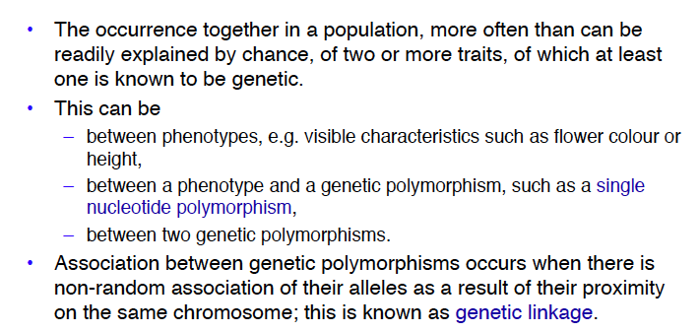
Phenotype/SNP in red box above is the main type in genome-wide association (GWAS),
enabled by assays for ~ 1 million SNPs per determination

Slide 4
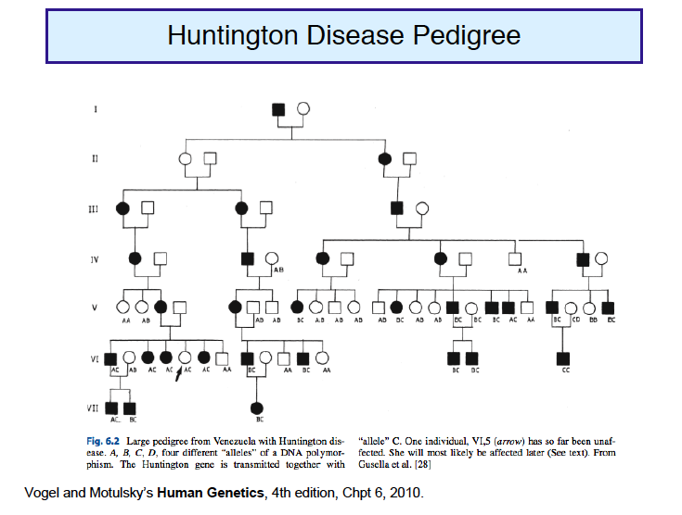
HD example below does several things: inspection of genotype for a linked
RFLP illustrates intuitively linkage, basis for mapping from linkage model in
Big pedigree, and clear crisp association of marker geneotype (allele C) with HD
Appreciate that near-perfect
penetrance, true and large
pedigree, simple dominant pattern
make this visible so simply
Classic one gene-one disease
instance

Slide 5
What do you do for a putative simple Mendelian disease
for which you lack huge and deep pedigrees?
This is a significant problem for most contemporary studies in US populations.
[The exception is large Northeren European pedigrees from Utah Morman
Families; very strong family records and medical records.]
Alternatives
1. Use many small families and in them compare affected vs unaffected
sibling pairs as leverage [This does not require phasing information]
2. Let Biology guide you to high quality and limited number of candidate genes
then go to geneticists with collections of patients and family members
3. Leap directly to candidate causal gene identification by whole
Exome Sequencing
Ng, Shendure, Nickerson et al from University of Washington Nature
Genetics 2010

Slide 6
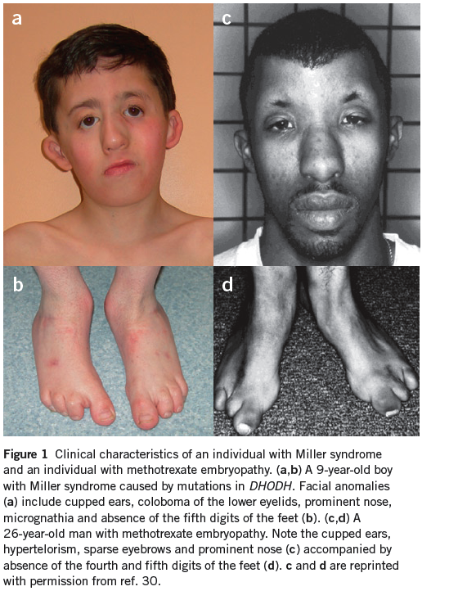
Exome sequencing
In 3 families finds the
Gene responsible when
Other methods failed
Very few examples
Small families
Inheritance model unclear
Note: when families are
Small it is very hard to
Tell the difference between
Sporadic dominant and
Rare recessive
This will likely be the
endgame for many rare
Mendelian disorders

Slide 7
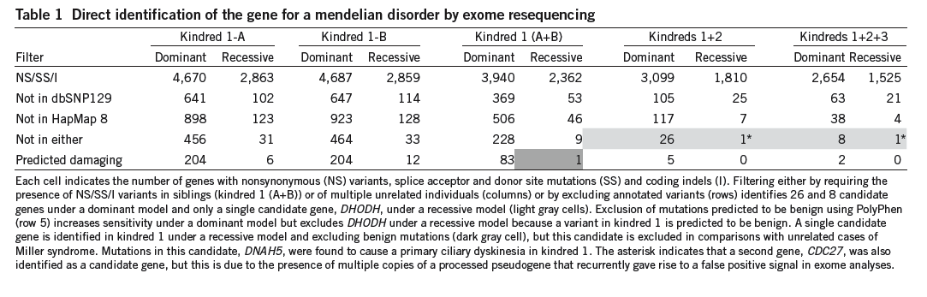
From Ng et al. Note how important filtering is to eliminate sequence differences
That are not good candidates but appear in whole exome data.
Notice the dependency on dominant vs recessive model and issue with using
Computational predictions for how deleterious each change might be to protein
Note the other recessive gene in the siblings under recessive model - DNAH5, a dynein
Protein known to produce a ciliopathy -- which these kids have symptoms of!
So the hunt was successful twice, but only one gene applied to Miller’s syndrome.

Slide 8
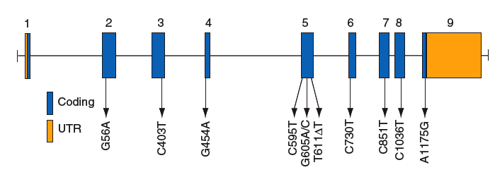
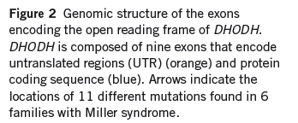
From Ng et al. Gene is DODH = de novo pyrimidine biosynthesis gene; Clearly would not have been guessed based on the whole organism phenotype
The diversity of alleles is high from the six families (10 different ones)
Note that after the whole exome sequencing on four individuals in three families,
They then added additional cases from three more families. There is a strong
prediction to test the initial favored candidate gene and the effort to go directly
To this gene to look for mutation is vastly simpler, faster, cheaper that more
Entire cases.

Slide 9
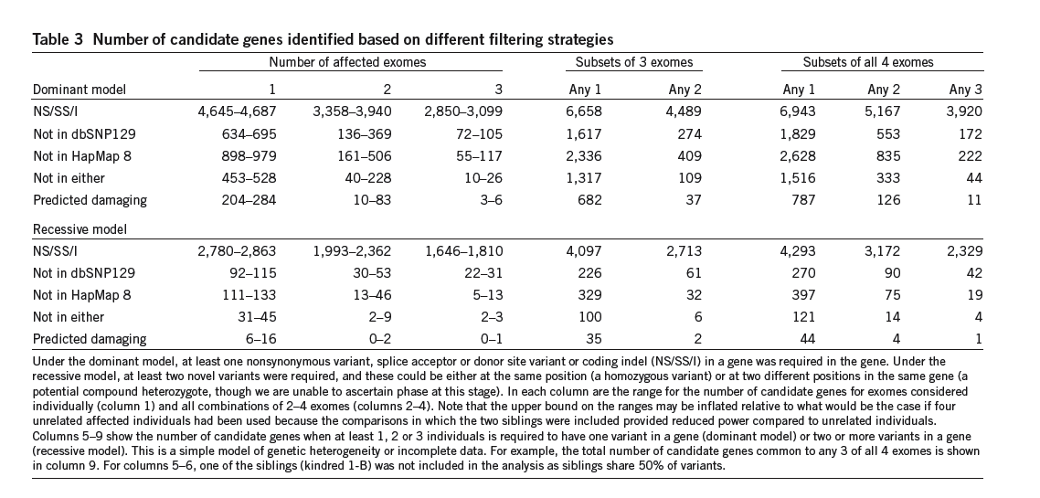
Bonferroni correction was applied for interrogating ~17000 genes
although with some broad assumptions -> still significant.
Recessive model favored because they could see compound heterozygosity at this locus in each affected individual in the
primary search group. In the sibs, they are the same pair.
Confirmation included final more reliable Sanger capillary sequencing

Slide 10
Heritability (h²) is a measure of the strength of genetic effects on a trait.
In its most general sense, heritability is the proportion of phenotypic variance (σ_{p}²) in a trait that is attributable to genetic effects (σ_{g}²)
h² = σ_{p}² / σ_{g}²
Al-Chalabi and Almasy. Genetics of Complex Human Diseases, Chapter 5

Slide 11
Current heritability measurements for three complex traits (take these with a grain of salt and remember how hard it is even to diagnose some of these diseases):
Schizophrenia: 40% (based on monozygotic twin study in 2007¹)
Autism: first 90% (based on study of young twins in 2001²) and then 30% (based on adult sibling study³). Life expectancy and definition of Autism spectrum may account for much of the difference
Blood pressure disorders 60%
¹ Picchioni MM, Murray RM. Schizophrenia. BMJ 2007
² Folstein SE, Rosen-Sheidley B. Genetics of autism: complex aetiology for a heterogeneous disorder. Nat Rev Genet 2001
³ Freitag CM. The genetics of autistic disorders and its clinical relevance: a review of the literature. Mol Psychiatry 2007

Slide 12
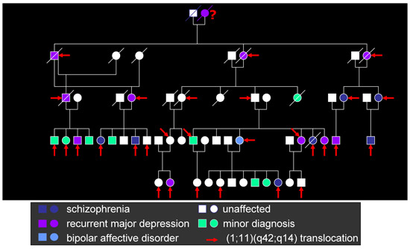
Founding Scottish pedigree first presented a (somewhat messy) Mendelian. {Not a major player in the majority of schizophrenics} Translocation T1:11 segregating in major mental illness family DISC1 (Disrupted in Schizophrenia) identified in this manner Consistent with Mendelian dominant (haplo-insufficient, novel product? think about how you would test for different possibilities)
Schizophrenia raises issues of complex genetic diseases:
Multiple genes; penetrence issues (see red arrows below); phenotyping complexity; and
uncertain environmental interactions implied by identical twin studies (h= heritability)
A major and unexpected conclusion emerging in neuro-psychiatric diseases is the apparent involvement of some (many?) genes in multiple disorders that we view as quite different phenotypically. Note here diagnoses of major depression and bipolar a well as schizophrenia

Slide 13
The underlying hypothesis behind Genome-wide association
Studies (GWAS) is that relatively few common alleles are
the major genetic components,when summed,
in complex disease.
Relatively common, in this context,
means above 1% (older papers emphasize above 5%)
A major alternative hypothesis is that the genetic component
of complex disease comes from the summation of many rare
alleles of high effect
Consider later the case of a set of genes whose mutation leads
to lower blood pressure (very low in homozygotes;
Healthy low, it appears, in heterozygotes). (see paper from
R. Lifton and colleagues - Ji et al., 2008)
First, though, GWAS on sickel cell anemia……

Slide 14
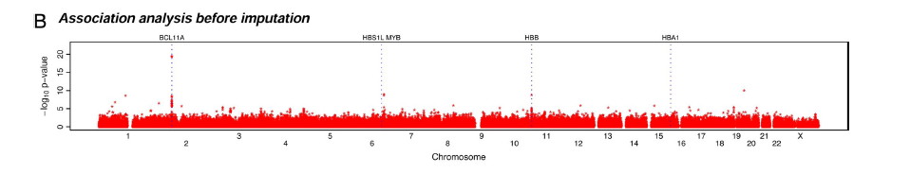
Example of GWAS successfully finding a modifier gene
Of great possible (not yet successful) drug development use
Sickle cell anemia is thought of by many as a simple mendelian which sometimes
is modified when heterozygous with thalasemia alleles. But it much is more
nuanced than that.
Some people with Sickle cell do vastly better than the majority. Orkin and colleagues
Focused on these cases for an association search.
Most successful finding so far was at BCL11a, a transcriptional repressor.
Above GWA panel from Uda et al (your reading)
Because it is a repressor mutation or model system inhibition by SRNA significantly
restores fetal (gamma) globin synthesis, this is welcome biology (at last) of
The locus and its transacting factors. It also strongly suggests that a pharmaceutical
Inhibitor of BCL11a would be tolerated (if not toxic for other reasons) and could
Significantly treat sickle cell patients and beta thalasemia patients

Slide 15
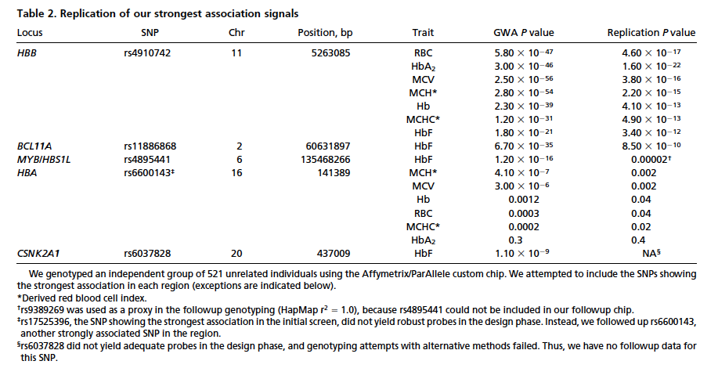
Replication in a new group of subjects
Note that the P value obtained was not nearly as impressive. This is often seen.

Slide 16
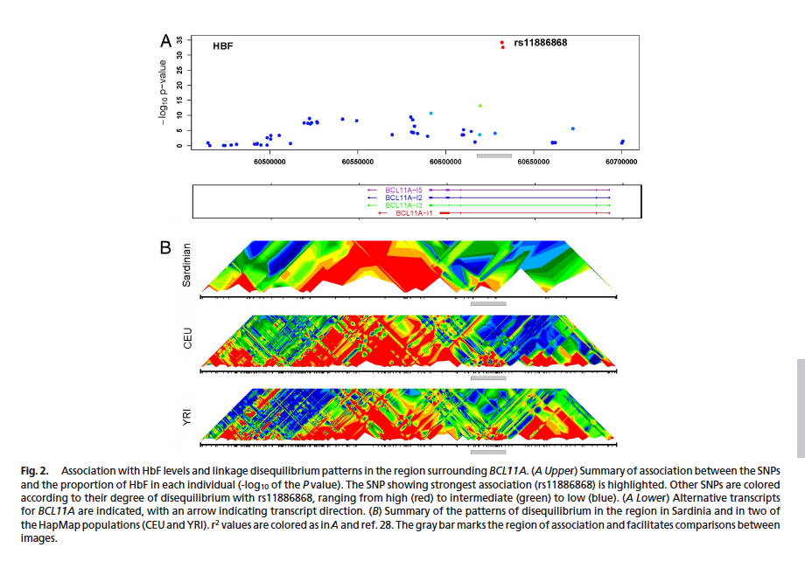

Slide 17
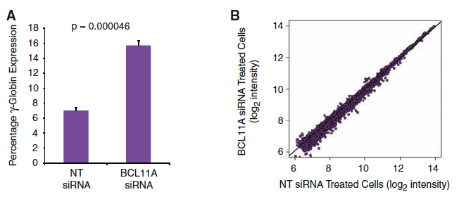
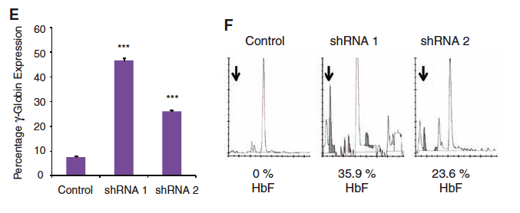
siRNA (control labeled NT) or reactive to BCL11a
Gamma globin significantly induced

Slide 18
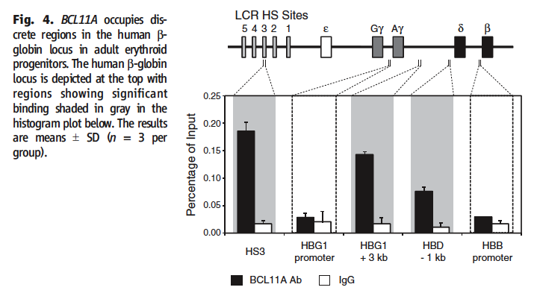
Chromatin immunoprecipitaton evidence of binding at candidate
Cis-regulatory regions in the non-coding parts of the globin locus

Slide 19
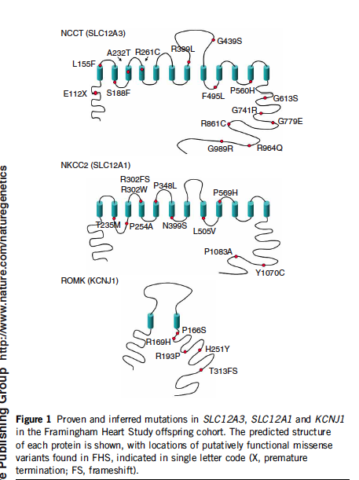
20 genes have been found
As Mendelian disease predisposers
In regulation of blood pressure
Both high and low- many with
Very very strong phenotypes as
heterzygotes.
However, blood pressure
(and associated salt metabolism)
Are quantitative tras varying over
a continuum.
Three yielding low BP
When mutated surveyed in
Framingham study ~3,000
By DNA sequencing exomes(+)
Of these known genes (modest
Size expt - bigger cohort wanted).

Slide 20
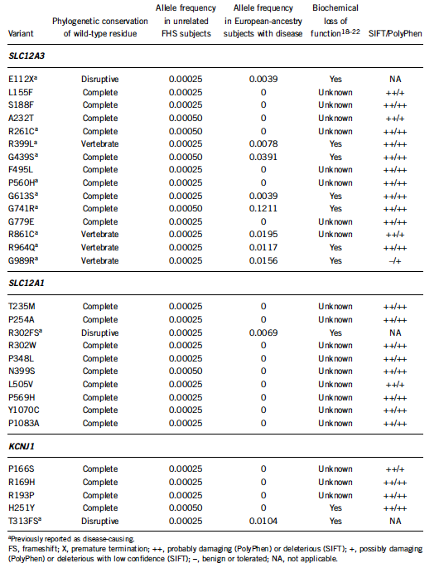
Take home lesson re allele
Frequency, taken at face value,
Is low in sample (singletons)

Slide 21
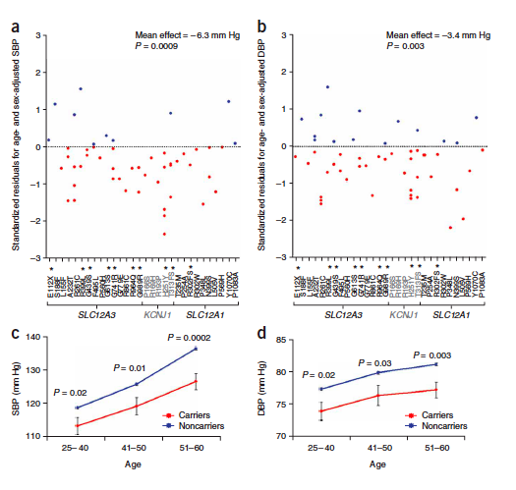
So what is phenotype of carriers of putatively hypomorphic
alleles in these genes?

Slide 22
The following series is bonus material, except that I want you
to get the basic underlying point and a good example to
think about: Not all genetics begins
With geneticists and any form of inheritance study. Can
Increasingly be the other way around.
It is on BBS, the slides being modified slightly
from those of field leader Dr. Peter Jackson of UCSF
then Genentech.
This illustrates, among other things, the intersection
of proteomics, rather than functional genomics, approaches
With human genetics of BBS syndrome which
Currently identifies 14 genes with a syndrome
Centered around the cellular organelle known as
The primary cilium. It is mainly understood as a
specialized signaling organelle.
It also shows how, with a group of candidate genes, you can
Drive the attribution of multiple forms of a genetic disorder
That had not been solved by straight genetics.

